Slide 1
Chapter 12 Exception Handling and Text IO

Slide 2
Motivations
When a program runs into a runtime error, the program terminates abnormally. How can you handle the runtime error so that the program can continue to run or terminate gracefully? This is the subject we will introduce in this chapter.

Slide 3
Objectives
To get an overview of exceptions and exception handling.
To explore the advantages of using exception handling.
To distinguish exception types: Error (fatal) vs. Exception (nonfatal) and checked vs. unchecked.
To declare exceptions in a method header.
To throw exceptions in a method.
To write a try-catch block to handle exceptions.
To explain how an exception is propagated.
To obtain information from an exception object.
To develop applications with exception handling.
To use the finally clause in a try-catch block.
To use exceptions only for unexpected errors.
To rethrow exceptions in a catch block.
To define custom exception classes.

Slide 4
Programming Errors
Syntax Errors
– Detected by the compiler
Runtime Errors
– Causes the program to abort
Logic Errors
– Produces incorrect result

Slide 5
Exception-Handling Overview
An exception is an object that represents
an error or a condition that prevents execution from proceeding normally.
Exceptions are thrown from a method. The caller of the method can catch and handle the exception.
Notes:
Examples: ArrayIndexOutOfBoundsException, InputMismatchException , ClassCastException

Slide 6
Exception-Handling Overview
Show runtime error
Quotient
Run
Fix it using an if statement
QuotientWithIf
Run
With a method
QuotientWithMethod
Run

Slide 7
Exception-Handling Example
QuotientWithException
Run

Slide 8
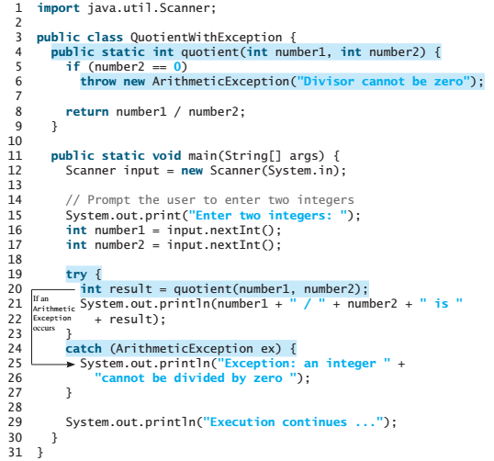
Exception-Handling
The value thrown is called an exception.
The execution of a throw statement is called throwing an exception.
When an exception is
thrown, the normal
execution flow is interrupted.

Slide 9
Exception-Handling
The try block contains
the code that is executed
in normal circumstances.
The exception is caught by the catch block.
The code in the catch block is
executed to handle the exception.
Afterward, the statement after the catch block is executed.

Slide 10
A template for a try-throw-catch block
try {
Code to run;
A statement or a method that may throw
an exception;
More code to run;
}
catch (type ex) {
Code to process the exception;
}

Slide 11
Exception Advantages
Now you see the advantages of using exception handling.
It enables a method to throw an exception to its caller.
Without this capability, a method must handle the exception or terminate the program.
An exception may be thrown directly by using a throw statement in a try block, or by invoking a method that may throw an exception.

Slide 12
Handling InputMismatchException
InputMismatchExceptionDemo
Run
By handling InputMismatchException, your program will continuously read an input until it is correct.

Slide 13

Exception Types
Exceptions are objects, and objects are defined using classes.
The root class for exceptions is java.lang.Throwable.

Slide 14
System Errors
System errors are thrown by JVM and represented in the Error class. The Error class describes internal system errors. Such errors rarely occur. If one does, there is little you can do beyond notifying the user and trying to terminate the program gracefully.

Slide 15
Exceptions
Exception describes errors caused by your program and external circumstances. These errors can be caught and handled by your program.

Slide 16
Runtime Exceptions
RuntimeException is caused by programming errors, such as bad casting, accessing an out-of-bounds array, and numeric errors.

Slide 17
Checked Exceptions vs. Unchecked Exceptions
RuntimeException, Error and their subclasses are known as unchecked exceptions.
All other exceptions are known as checked exceptions, meaning that the compiler forces the programmer to check and deal with the exceptions.

Slide 18
Unchecked Exceptions
In most cases, unchecked exceptions reflect programming logic errors that are not recoverable.
For example, a NullPointerException is thrown if you access an object through a reference variable before an object is assigned to it;
an IndexOutOfBoundsException is thrown if you access an element in an array outside the bounds of the array.
These are the logic errors that should be corrected in the program. Unchecked exceptions can occur anywhere in the program. To avoid cumbersome overuse of try-catch blocks, Java does not mandate you to write code to catch unchecked exceptions.

Slide 19
Unchecked Exceptions
Unchecked exception.

Slide 20

Declaring, Throwing, and Catching Exceptions

Slide 21
Declaring Exceptions
Every method must state the types of checked exceptions it might throw. This is known as declaring exceptions.
public void myMethod() throws IOException
public void myMethod()
throws IOException, OtherException

Slide 22
Throwing Exceptions
When the program detects an error, the program can create an instance of an appropriate exception type and throw it. This is known as throwing an exception. Here is an example,
throw new TheException();
TheException ex = new TheException();
throw ex;

Slide 23
Throwing Exceptions Example
/** Set a new radius */
public void setRadius(double newRadius)
throws IllegalArgumentException {
if (newRadius >= 0)
radius = newRadius;
else
throw new IllegalArgumentException(
"Radius cannot be negative");
}

Slide 24
Catching Exceptions
try {
statements; // Statements that may throw exceptions
}
catch (Exception1 exVar1) {
handler for exception1;
}
catch (Exception2 exVar2) {
handler for exception2;
}
...
catch (ExceptionN exVar3) {
handler for exceptionN;
}

Slide 25

Catching Exceptions

Slide 26
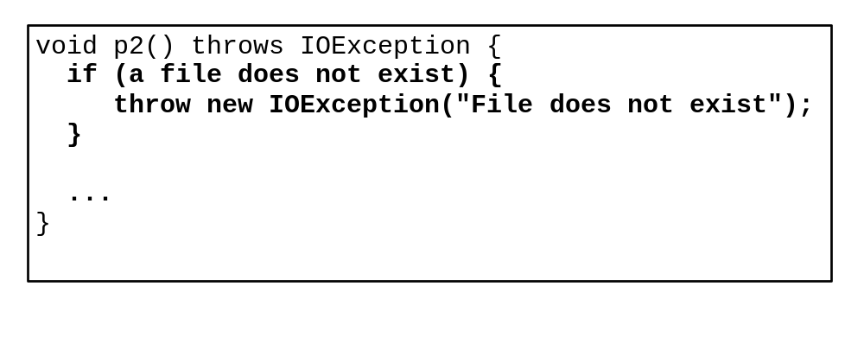
Catch or Declare Checked Exceptions
Suppose p2 is defined as follows:

Slide 27
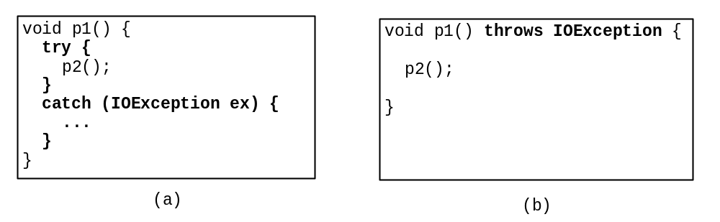
Catch or Declare Checked Exceptions
Java forces you to deal with checked exceptions. If a method declares a checked exception (i.e., an exception other than Error or RuntimeException), you must invoke it in a try-catch block or declare to throw the exception in the calling method. For example, suppose that method p1 invokes method p2 and p2 may throw a checked exception (e.g., IOException), you have to write the code as shown in (a) or (b).

Slide 28
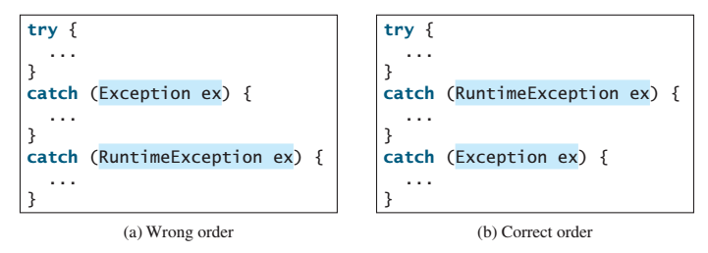
Order of Exception Handlers
The order in which exceptions are specified in catch blocks is important.
A compile error will result if a catch block for a superclass type appears before a catch block for a subclass type.
For example, the ordering in (a) is erroneous, because RuntimeException is a subclass of Exception.
The correct ordering should be as shown in (b).

Slide 29
Example: Declaring, Throwing, and Catching Exceptions
Objective: This example demonstrates declaring, throwing, and catching exceptions by modifying the setRadius method in the Circle class defined in Chapter 8. The new setRadius method throws an exception if radius is negative.
TestCircleWithException
CircleWithException
Run

Slide 30
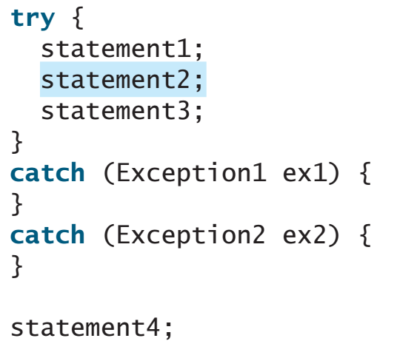
Exercise #1:
Suppose that statement2 causes an exception in the following try-catch block:
Will statement3 be executed?
If the exception is not caught, will statement4 be executed?
If the exception is caught in the catch block, will statement4 be executed?
No!
No!
Yes!

Slide 31
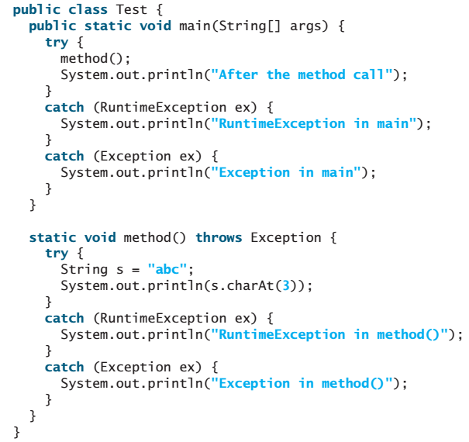
Exercise #2:
What is displayed when the following program is run?
RuntimeException in method()
After the method call

Slide 32
Rethrowing Exceptions
try {
statements;
}
catch(TheException ex) {
perform operations before exits;
throw ex;
}

Slide 33
The finally Clause
The finally clause is always executed regardless whether an exception occurred or not.
try {
statements;
}
catch(TheException ex) {
handling ex;
}
finally {
finalStatements;
}

Slide 34
Trace a Program Execution
animation
Suppose no exceptions in the statements
try {
statements;
}
catch(TheException ex) {
handling ex;
}
finally {
finalStatements;
}
Next statement;

Slide 35
Trace a Program Execution
animation
The final block is always executed
try {
statements;
}
catch(TheException ex) {
handling ex;
}
finally {
finalStatements;
}
Next statement;

Slide 36
Trace a Program Execution
animation
Next statement in the method is executed
try {
statements;
}
catch(TheException ex) {
handling ex;
}
finally {
finalStatements;
}
Next statement;

Slide 37
Trace a Program Execution
animation
try {
statement1;
statement2;
statement3;
}
catch(Exception1 ex) {
handling ex;
}
finally {
finalStatements;
}
Next statement;
Suppose an exception of type Exception1 is thrown in statement2

Slide 38
Trace a Program Execution
animation
try {
statement1;
statement2;
statement3;
}
catch(Exception1 ex) {
handling ex;
}
finally {
finalStatements;
}
Next statement;
The exception is handled.

Slide 39
Trace a Program Execution
animation
try {
statement1;
statement2;
statement3;
}
catch(Exception1 ex) {
handling ex;
}
finally {
finalStatements;
}
Next statement;
The final block is always executed.

Slide 40
Trace a Program Execution
animation
try {
statement1;
statement2;
statement3;
}
catch(Exception1 ex) {
handling ex;
}
finally {
finalStatements;
}
Next statement;
The next statement in the method is now executed.

Slide 41
Trace a Program Execution
animation
try {
statement1;
statement2;
statement3;
}
catch(Exception1 ex) {
handling ex;
}
catch(Exception2 ex) {
handling ex;
throw ex;
}
finally {
finalStatements;
}
Next statement;
statement2 throws an exception of type Exception2.

Slide 42
Trace a Program Execution
animation
try {
statement1;
statement2;
statement3;
}
catch(Exception1 ex) {
handling ex;
}
catch(Exception2 ex) {
handling ex;
throw ex;
}
finally {
finalStatements;
}
Next statement;
Handling exception

Slide 43
Trace a Program Execution
animation
try {
statement1;
statement2;
statement3;
}
catch(Exception1 ex) {
handling ex;
}
catch(Exception2 ex) {
handling ex;
throw ex;
}
finally {
finalStatements;
}
Next statement;
Execute the final block

Slide 44
Trace a Program Execution
animation
try {
statement1;
statement2;
statement3;
}
catch(Exception1 ex) {
handling ex;
}
catch(Exception2 ex) {
handling ex;
throw ex;
}
finally {
finalStatements;
}
Next statement;
Rethrow the exception and control is transferred to the caller

Slide 45
Cautions When Using Exceptions
Exception handling separates error-handling code from normal programming tasks, thus making programs easier to read and to modify.
Be aware, however, that exception handling usually requires more time and resources because it requires instantiating a new exception object, rolling back the call stack, and propagating the errors to the calling methods.

Slide 46
When to Throw Exceptions
An exception occurs in a method.
If you want the exception to be processed by its caller, you should create an exception object and throw it.
If you can handle the exception in the method where it occurs, there is no need to throw it.

Slide 47
When to Use Exceptions
When should you use the try-catch block in the code? You should use it to deal with unexpected error conditions. Do not use it to deal with simple, expected situations.
For example, the following code
try {
System.out.println(refVar.toString());
}
catch (NullPointerException ex) {
System.out.println("refVar is null");
}

Slide 48
When to Use Exceptions
is better to be replaced by
if (refVar != null)
System.out.println(refVar.toString());
else
System.out.println("refVar is null");

Slide 49
Defining Custom Exception Classes
Use the exception classes in the API whenever possible.
Define custom exception classes if the predefined classes are not sufficient.
Define custom exception classes by extending Exception or a subclass of Exception.

Slide 50
Custom Exception Class Example
In Listing 13.8, the setRadius method throws an exception if the radius is negative. Suppose you wish to pass the radius to the handler, you have to create a custom exception class.
InvalidRadiusException
CircleWithRadiusException
TestCircleWithRadiusException
Run

Slide 51
Text I/O
Notes:
Data stored in the program are temporary; they are lost when the program terminates.
To permanently store the data created in a program, you need to save them in a file on a disk.
The file can then be transported and read later by other programs.

Slide 52
Objectives
To discover file/directory properties, to delete and rename files/directories, and to create directories using the File class.
To write data to a file using the PrintWriter class.
To use try-with-resources to ensure that the resources are closed automatically.
To read data from a file using the Scanner class.
To understand how data is read using a Scanner.
To develop a program that replaces text in a file.

Slide 53
The File Class
The File class is intended to provide an abstraction that deals with most of the machine-dependent complexities of files and path names in a machine-independent fashion.
The filename is a string.
The File class is a wrapper class for the file name and its directory path.
Notes:
Every file is placed in a directory in the file system.
Absolute file name
Relative file name
Do not use absolute file names in your program.

Slide 54
The File Class
The File class contains the methods
– for obtaining file and directory properties
– for renaming and deleting files and directories.
However, the File class does not contain
the methods for reading and writing file
content
Notes:
- Constructing a File instance does not create a file on the machine.

Slide 55
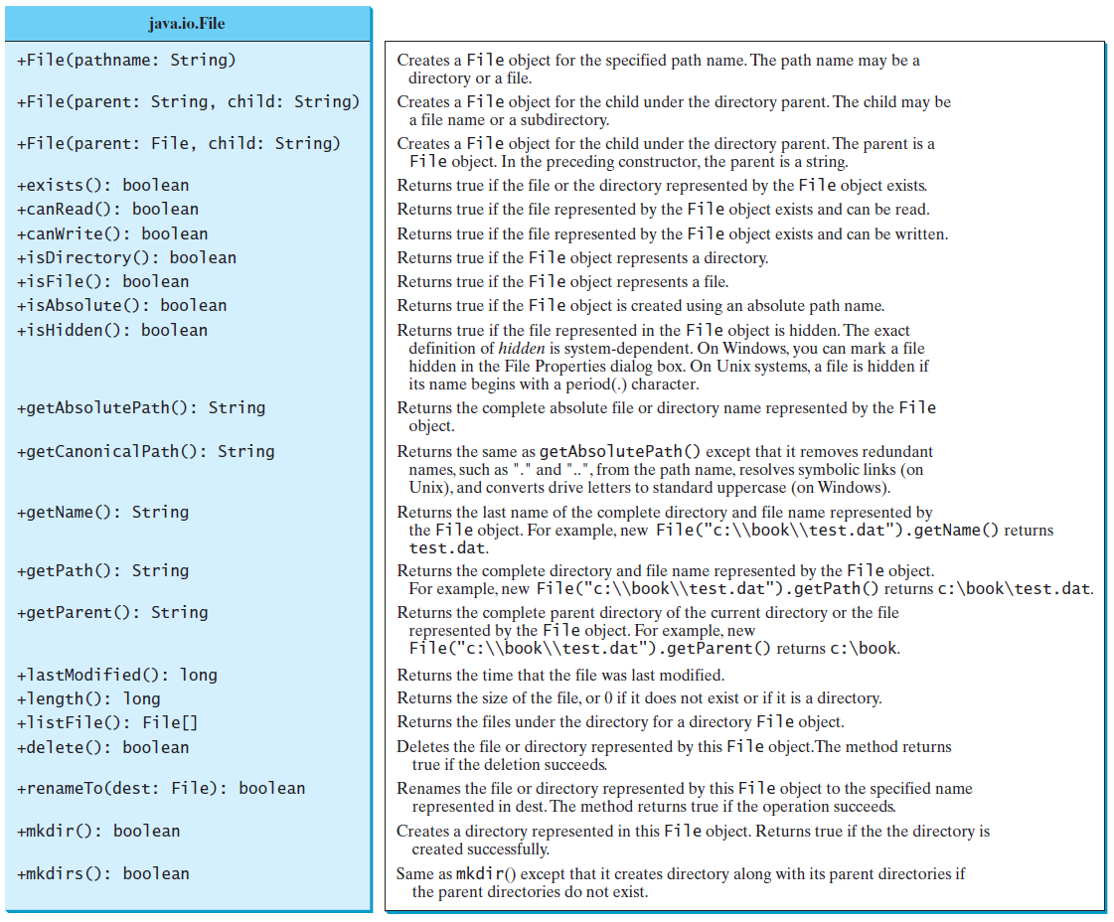
Obtaining file properties and manipulating file

Slide 56
Explore File Properties
java.io.File file = new java.io.File("image/us.gif");
System.out.println("Does it exist? " + file.exists());
System.out.println("The file has " + file.length() + " bytes");
System.out.println("Can it be read? " + file.canRead());
System.out.println("Can it be written? " + file.canWrite());
System.out.println("Is it a directory? " + file.isDirectory());
System.out.println("Is it a file? " + file.isFile());
System.out.println("Is it absolute? " + file.isAbsolute());
System.out.println("Is it hidden? " + file.isHidden());
System.out.println("Absolute path is " + file.getAbsolutePath());
System.out.println("Last modified on " +
new java.util.Date(file.lastModified()));
TestFileClass
Run

Slide 57
Text I/O
A File object encapsulates the properties of a file or a path, but does not contain the methods for reading/writing data from/to a file.
In order to perform I/O, you need to create objects using appropriate Java I/O classes.
The objects contain the methods for reading/writing data from/to a file.
This section introduces how to read/write strings and numeric values from/to a text file using the Scanner and PrintWriter classes.

Slide 58
Writing Data Using PrintWriter
The java.io.PrintWriter class can be used to create a file and write data to a text file.
First, you have to create a PrintWriter object for a text file as follows:
PrintWriter output = new PrintWriter(filename);
Then, you can invoke the print, println, and printf methods on the PrintWriter object to write data to a file.

Slide 59

Writing Data Using PrintWriter
WriteData
Run
Notes:
- Invoking the constructor of PrintWriter will create a new file if the file does not exist.
If the file already exists, the current content in the file will be discarded without verifying with the user.
Invoking the constructor of PrintWriter may throw an I/O exception.
The close() method must be used to close the file. If this method is not invoked, the data may not be saved properly in the file.

Slide 60
Try-with-resources
Programmers often forget to close the file. JDK 7 provides the followings new try-with-resources syntax that automatically closes the files.
try (declare and create resources) {
Use the resource to process the file;
}
WriteDataWithAutoClose
Run

Slide 61
Reading Data Using Scanner
To read from a file, create a Scanner for a
file, as follows:
Scanner input = new Scanner(new File(filename))

Slide 62
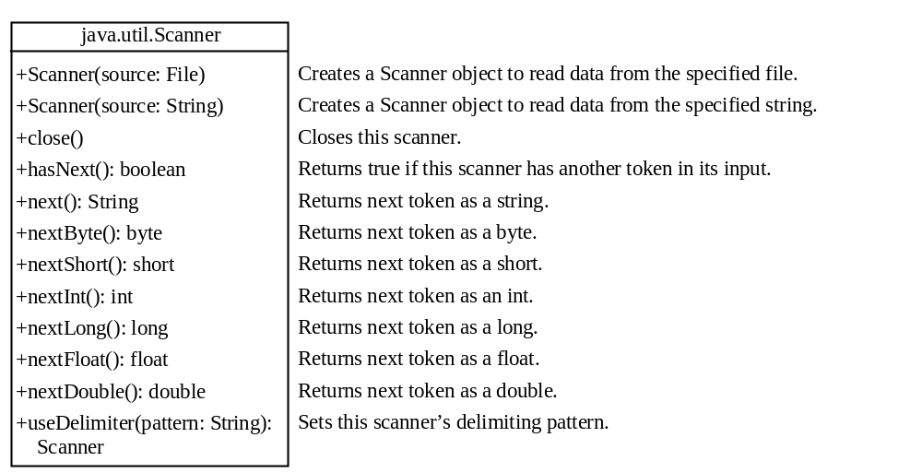
Reading Data Using Scanner
ReadData
Run

Slide 63
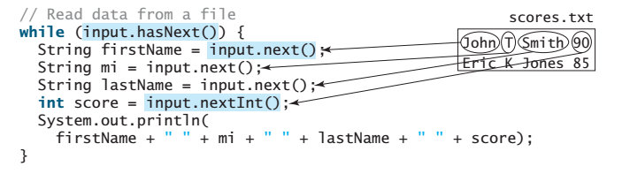
Example

Slide 64
Problem: Replacing Text
Write a class named ReplaceText that replaces a string in a text file with a new string. The filename and strings are passed as command-line arguments as follows:
  java ReplaceText sourceFile targetFile oldString newString
For example, invoking
  java ReplaceText FormatString.java t.txt StringBuilder StringBuffer
replaces all the occurrences of StringBuilder by StringBuffer in FormatString.java and saves the new file in t.txt.
ReplaceText
Run

